Slide 1

Artificial Intelligence in Biomedical Imaging Lab
(AIBIL – CBICA - UPENN)
NiChart
Neuro . Imaging . Chart
Presented by: Guray Erus
NiChart - Scientific Steering Committee Meeting , 05/26/2023
Notes:
<number>

Slide 2
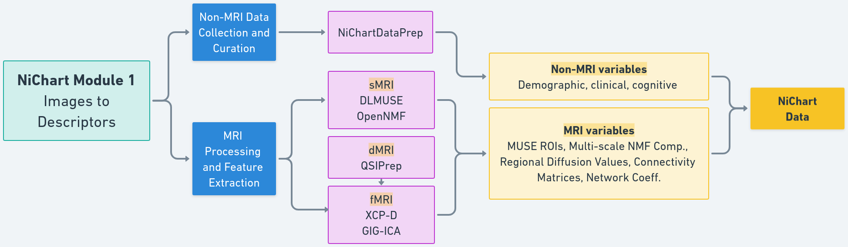
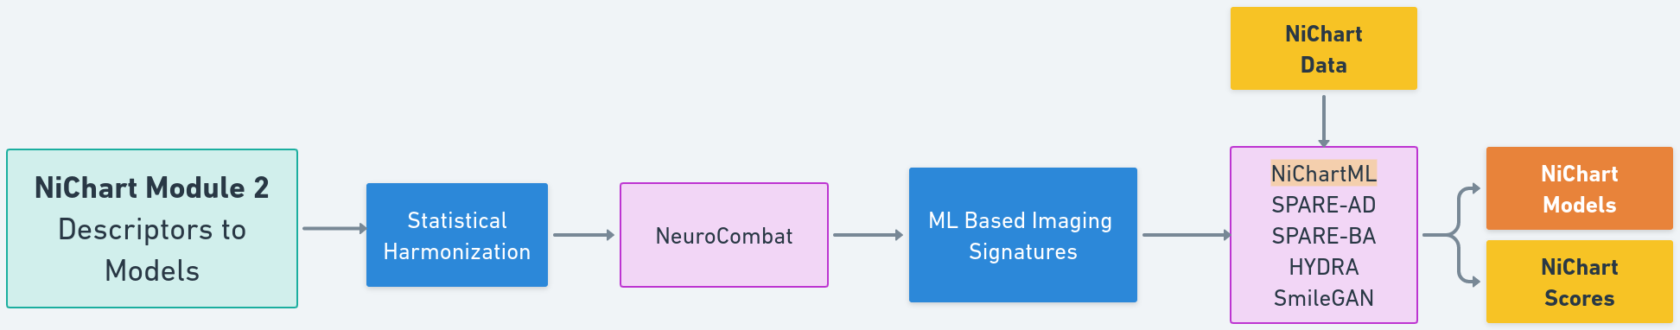
NiChart Overview
Data collection, processing and model training

Slide 3
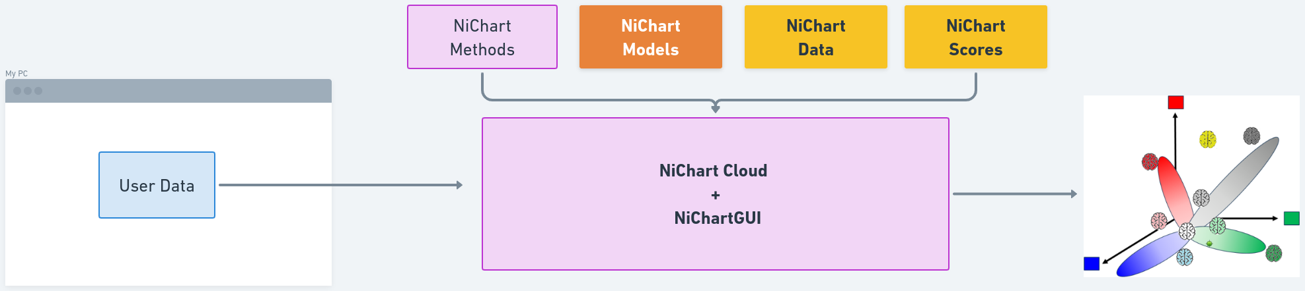
Application on user data

Slide 4
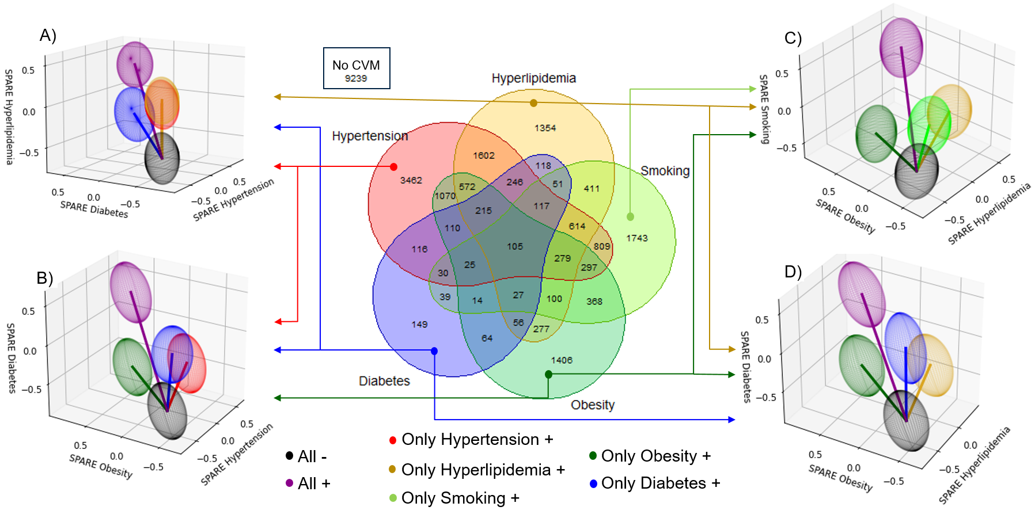
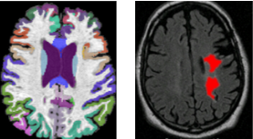
Illustrative example: Neuro-anatomical signatures of CVD risk factors
Govindarajan, S.T., et. al., Machine-learning based MRI neuro-anatomical signatures associated with cardiovascular and metabolic risk factors. In preparation for JAMA.

Slide 5
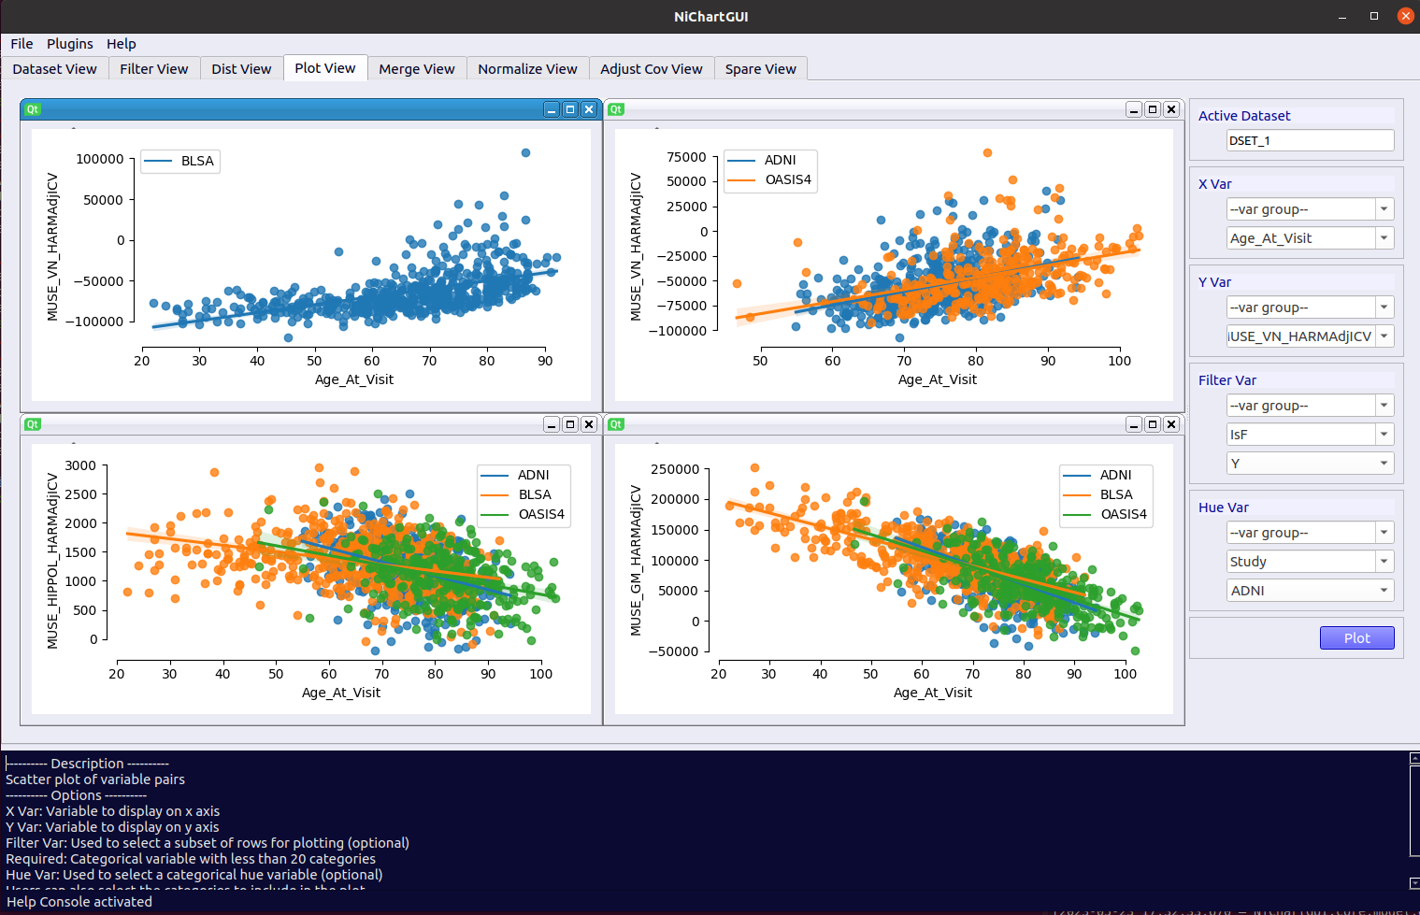
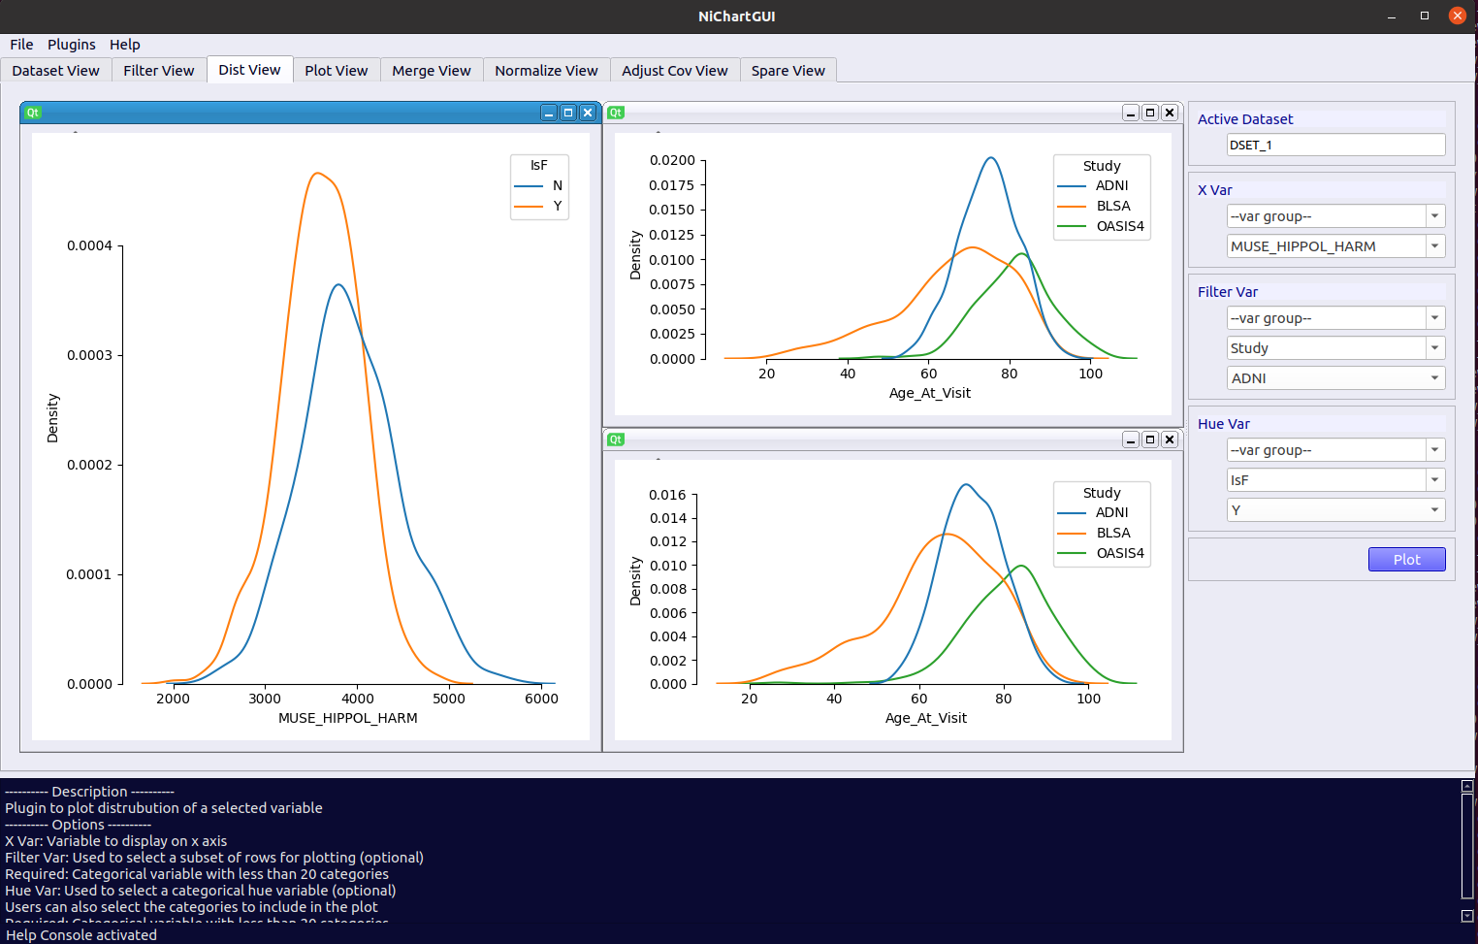
NiChart GUI

Slide 6
NiChart sMRI Pipelines

Slide 7
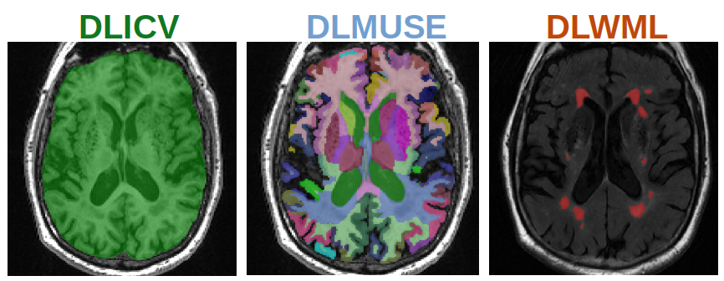
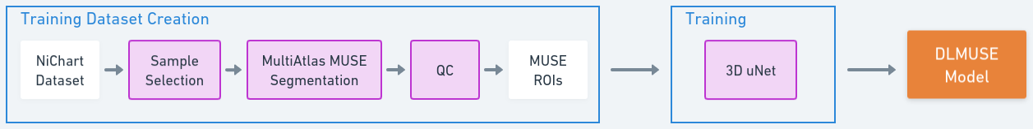
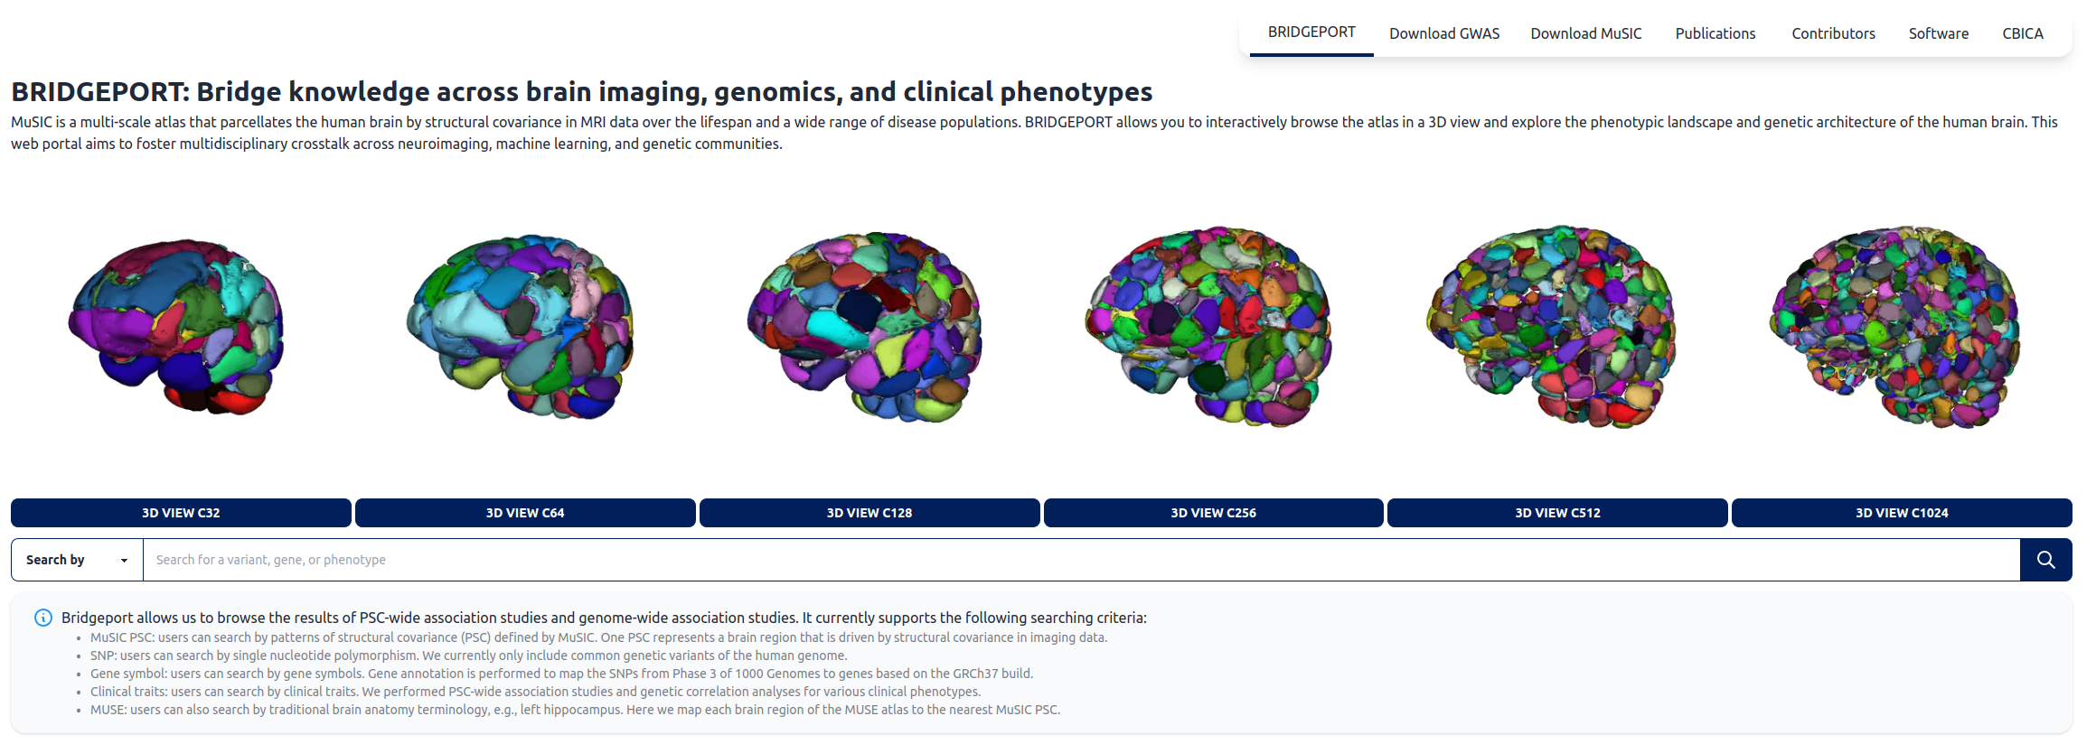
DL-based anatomical segmentation
Doshi, Jimit, et al. "DeepMRSeg: A convolutional deep neural network for anatomy and abnormality segmentation on MR images." arXiv preprint arXiv:1907.02110 (2019).
Data-driven multi-scale segmentation via structural covariance
Wen, J. et al. Novel genomic loci and pathways influence patterns of structural covariance in the human brain. medRxiv 2022.07.20.22277727; doi: https://doi.org/10.1101/2022.07.20.22277727

Slide 8
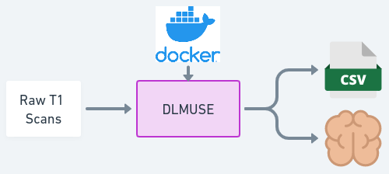
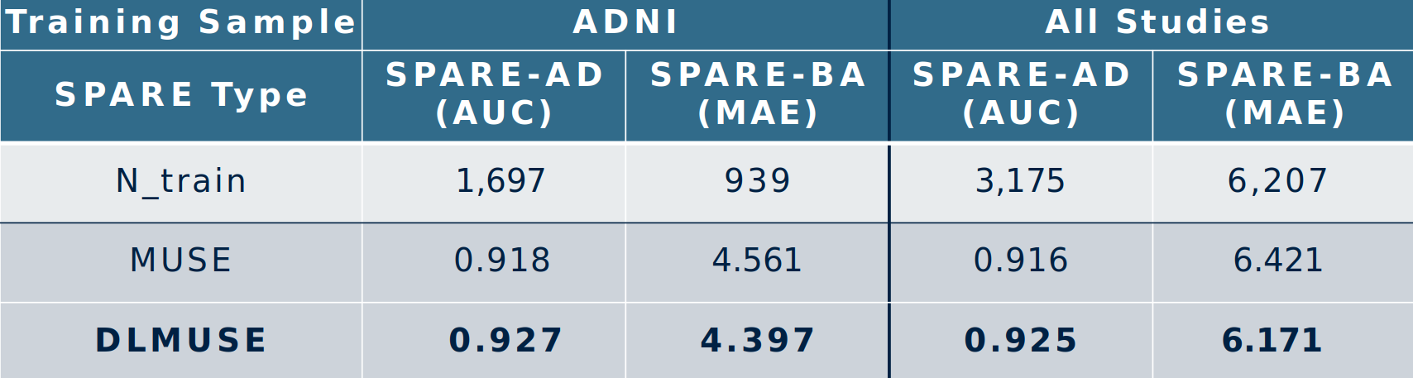
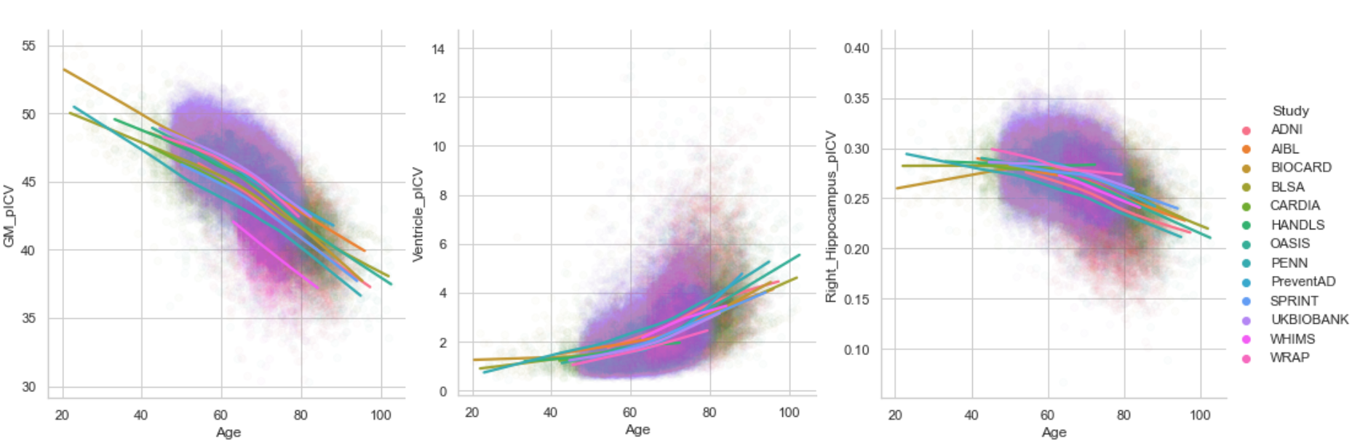
DLMUSE
Practical
Single scan inference time < 20 s.
Target for optimized model < 5 s.
Fast
Accurate

Slide 9
Thank you ...

